Slide 1

CO 5
Social Information Filtering

Slide 2
Outline
Social Information Sharing and filtering
Automated Recommendation systems
Traditional Recommendation Systems
Social Media and Business Alignment
Social Media KPI (Key Performance Indicator)
Formulating a Social Media Strategy, Managing Social Media Risks

Slide 3

Social Information Filtering
a process for organizing and filtering information based on social connections and relationships.
It can involve the use of algorithms and human judgment to identify relevant information.
It is used in a variety of contexts, including online social networks, news aggregators, and recommendation systems.
It can be used to surface relevant content to users based on their social connections and interests.

Slide 4
Social Information Sharing
Social information sharing refers to the exchange of information, ideas, and content among individuals within a social network or community.
It can take place through various channels, such as online social media platforms, messaging apps, forums, or in-person conversations.
Social information sharing can facilitate the spread of information and ideas, and can help to build connections and relationships among individuals.

Slide 5
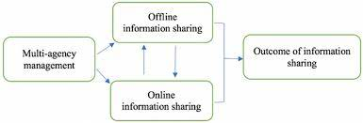
Social Information Sharing Schematic

Slide 6
Social Information Sharing
It can also have negative consequences, such as the spread of misinformation or the invasion of privacy.
The use of algorithms and other technologies can facilitate social information sharing by suggesting content to users or by helping to connect individuals with similar interests.

Slide 7
Social Information Sharing
Occupation
Subjective Norms
Social Media Information Sharing
Intentions
Perceived Value

Slide 8
Social Information Sharing
Social Media Information Sharing-
Subjective Norms-
Intentions-
Perceived Value-

Slide 9
Social Information Sharing Example
Considered Twitter Social Platform
Social Media Information Sharing-
Subjective Norms-
Intentions-
Perceived Value-

Slide 10
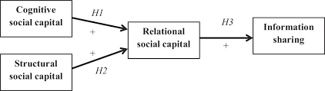
Social Sharing Example

Slide 11
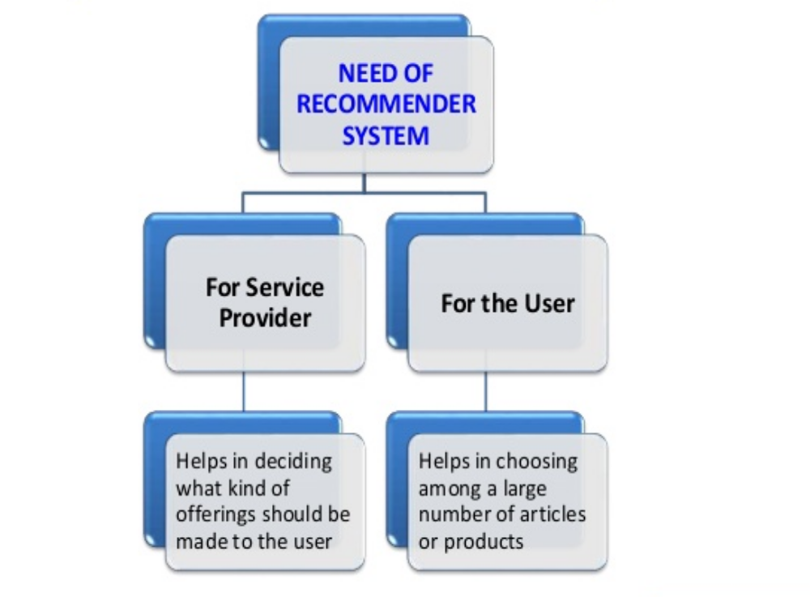
Need of Recommendation System

Slide 12
Automated Recommendation System
is a technology that uses algorithms to suggest content, products to users based on their interests and past behaviors.
can be used in a variety of contexts, such as online retail, streaming services, and social media.
They rely on user’s past actions, preferences, and demographic information, to make personalized recommendations.
It can improve the user experience by providing relevant and personalized recommendations.
It can also raise concerns about privacy and the potential for manipulation in the recommendations.

Slide 13
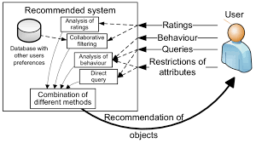
ARS Example

Slide 14
Traditional Recommendation Systems
These systems rely on human judgment and expertise to recommend products to users.
These systems can be used in a variety of contexts, such as bookstores, libraries, and music stores.
They may rely on personal recommendations from friends or trusted sources, or on reviews and ratings provided by other users.
These systems may be less personalized than automated systems, but they are more trustworthy and reliable.
They may be less efficient than automated systems, but they can also be more flexible and adaptable to the needs and preferences of individual users.

Slide 15

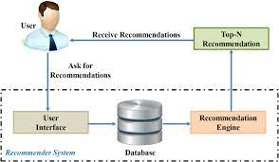
TRS Example

